Slide 1
Land Usage Monitoring Tool
AI-Powered Land Use Classification

Slide 2
Introduction
What is it?
A deep learning tool to classify land use (e.g., Urban, Forest, Water) from satellite images
Why it matters
- Supports urban planning
- Tracks deforestation
- Aids climate change analysis
Key Features
- U-Net model for segmentation
- Flask website for user predictions

Slide 3
Objectives
Goals:
- Build a U-Net model to segment 64x64 satellite images into 7 land use classes
- Create a user-friendly website for real-time predictions
- Achieve reliable classification with limited data
Dataset:
SEN-2 LULC (149,600 training, 32,079 validation/test images)

Slide 4
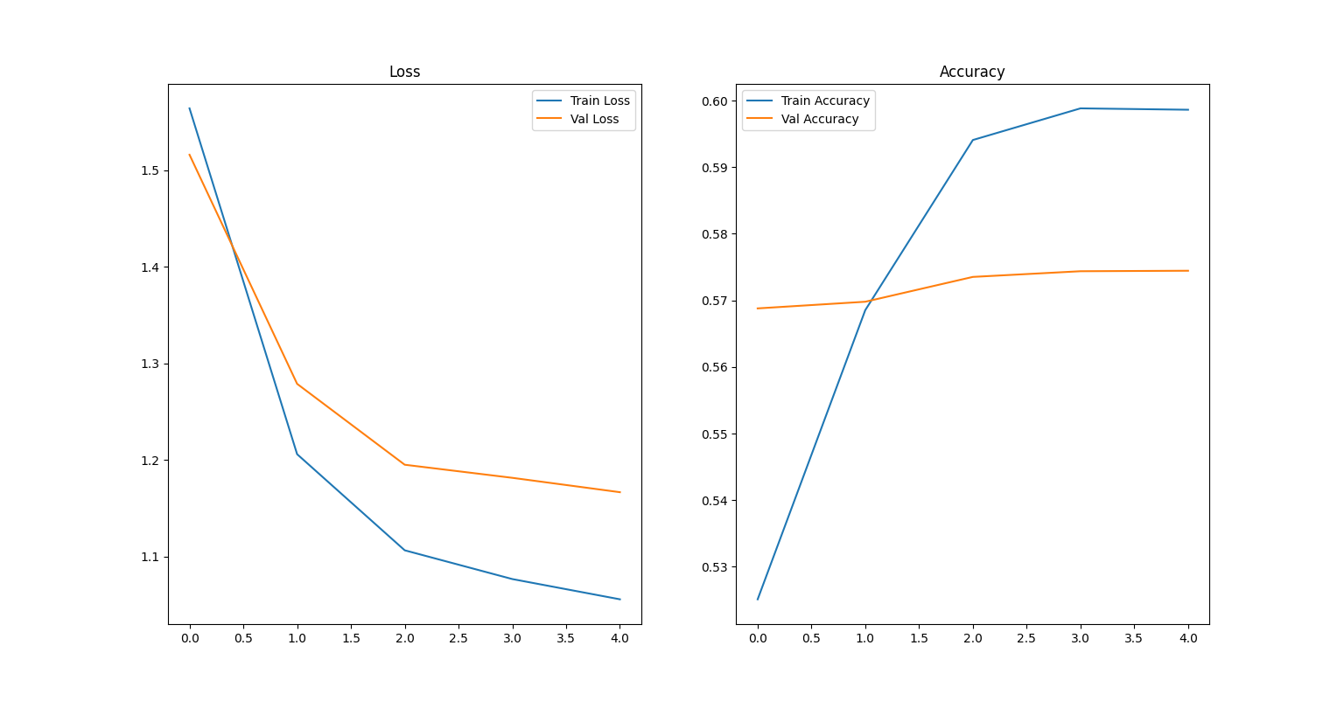
Project Components
Steps:
1. Environment Setup: Python 3.9, TensorFlow, Flask
2. Dataset Exploration: Verified 149,600 image-mask pairs
3. Model Training: U-Net, 50 samples, 5 epochs
4. Evaluation: Test on 20 samples
5. Website: Flask app for image uploads and predictions
`training_plot.png`

Slide 5
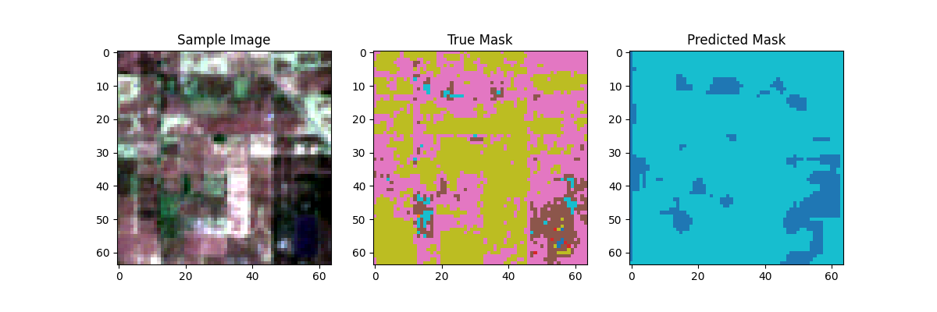
Results
Model Performance:
- Training Accuracy: \~59.95%
- Validation Accuracy: \~57.45%
- Loss: Decreased from 1.5605 to 1.0044
Outputs:
- `unet_model.h5`: Trained model
- `training_plot.png`: Loss/accuracy trends
- `prediction_plot.png`: Sample predictions
Website:
Delivers real-time predictions with class distributions (e.g., “Water: 4023 pixels”)
Visual:
`prediction_plot.png` (image, true mask, predicted mask)

Slide 6
Conclusion
Summary:
- Built a proof-of-concept for land use classification
- Achieved \~60% accuracy on a small dataset
- Deployed a functional Flask website
Impact:
- Enables environmental monitoring
- User-friendly for non-experts

